Slide 1


AtliQ
Hardware
AD-HOC INSIGHTS
Domain : Consumer Goods

Slide 2
Agenda
Overview
Ad-Hoc Queries and Visualizations
Data Model
Closing Remarks and Links

Slide 3
Overview
AtliQ Hardware is a leading computer hardware manufacturer based in India, renowned for its strong global presence. The company is committed to innovation and expansion, particularly in data analytics, aiming to strengthen insights and support strategic decision-making.
To achieve this, AtliQ Hardware is actively scaling its data analyst team, enhancing its ability to transform data into actionable business intelligence for sustained growth
About AtliQ
Atliq Hardware has initiated a SQL-based challenge to evaluate candidates for its analyst role, aiming to assess problem-solving abilities and data-driven decision-making skills.
The challenge is designed to generate key business insights and required reports, ensuring candidates can leverage structured queries to drive informed strategic decisions effectively.
Objective
AtliQ follow the fiscal year from September to August
Tools used in this submission are :
MySQL for Query Execution &
Power BI for Data Visualizations
Key Points

Slide 4
Data Model
fact_sales_monthly
date
fiscal year
product code
customer code
sold quantity
dim_product
product code
division
segment
category
product
variant
dim_customer
customer code
customer
platform
channel
market
sub zone
region
fact_post_inv_deduction
customer code
product code
date
discounts pct
other deduction pct
fact_pre_inv_deduction
customer code
fiscal year
pre invoice discount pct
fact_gross_price
product code
fiscal year
gross price
fact_manufacturing_cost
product code
cost year
manufacturing cost

Slide 5
Ad - Hoc
Queries and Visualizations

Slide 6
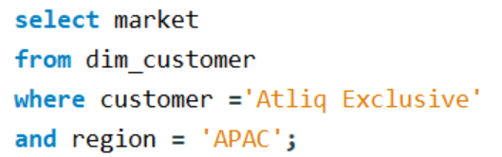
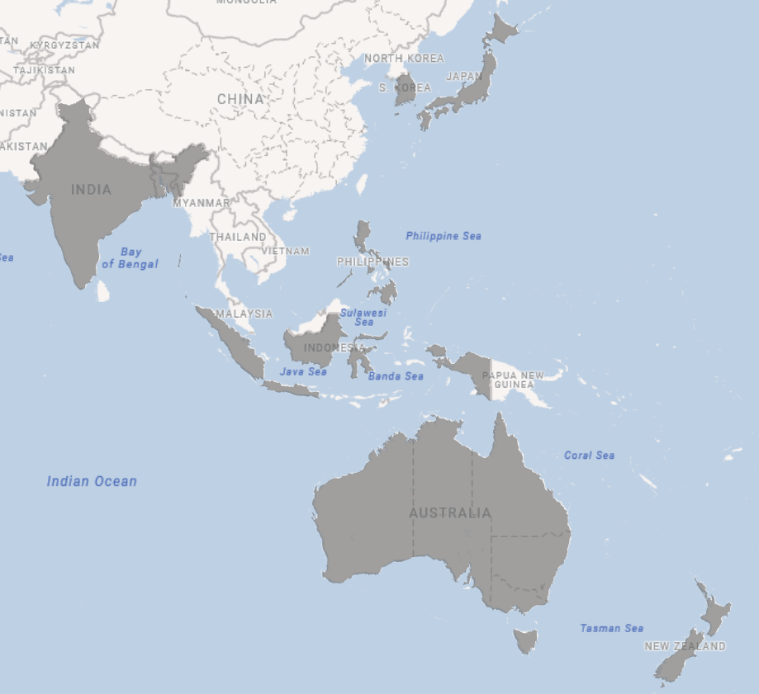
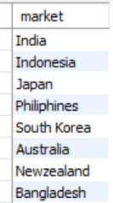
PROVIDE THE LIST OF MARKETS IN THE APAC REGION IN WHICH "ATLIQ EXCLUSIVE" OPERATES ITS BUSINESS.

Slide 7
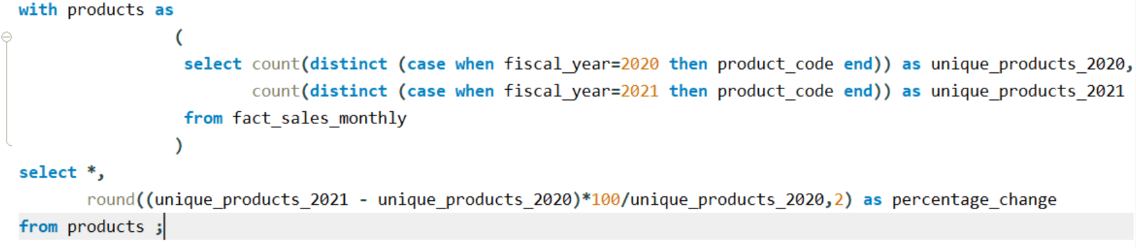
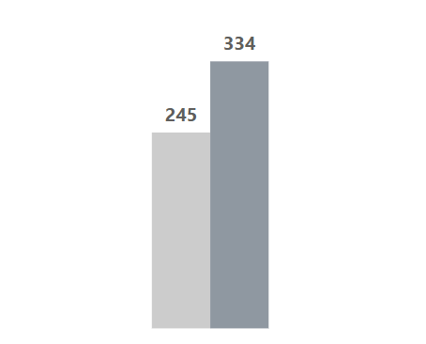

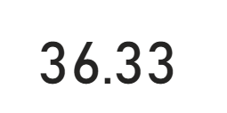
WHAT IS THE PERCENTAGE INCREASE OF UNIQUE PRODUCTS SOLD IN 2021 COMPARED TO 2020.
%

Slide 8
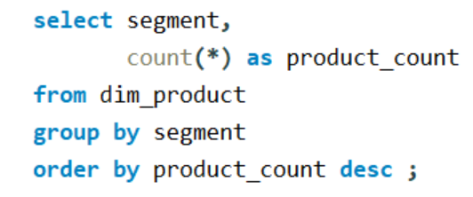
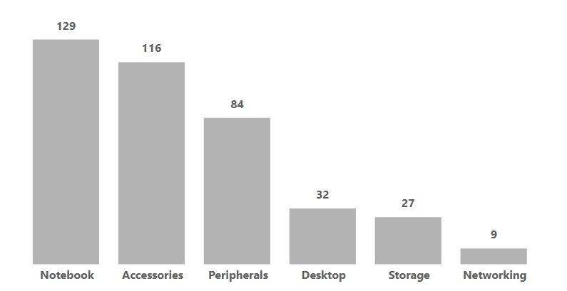
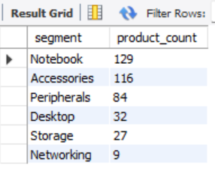
PROVIDE A REPORT WITH COUNT OF UNIQUE PRODUCTS FOR EACH SEGMENT IN DESCENDING ORDER.

Slide 9
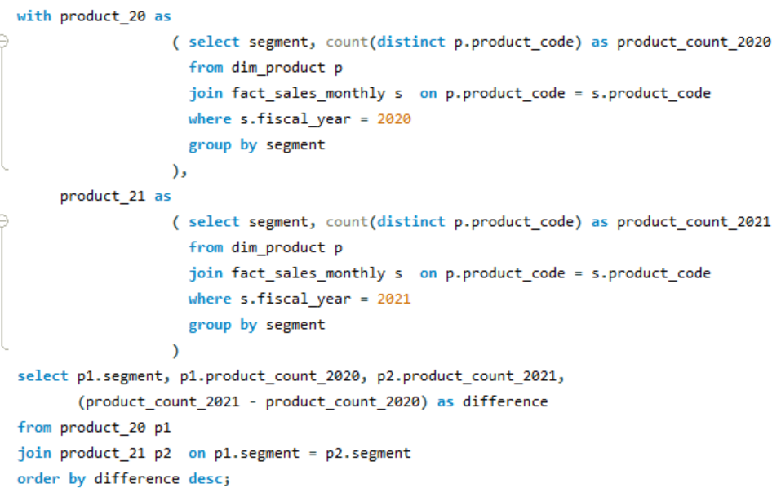
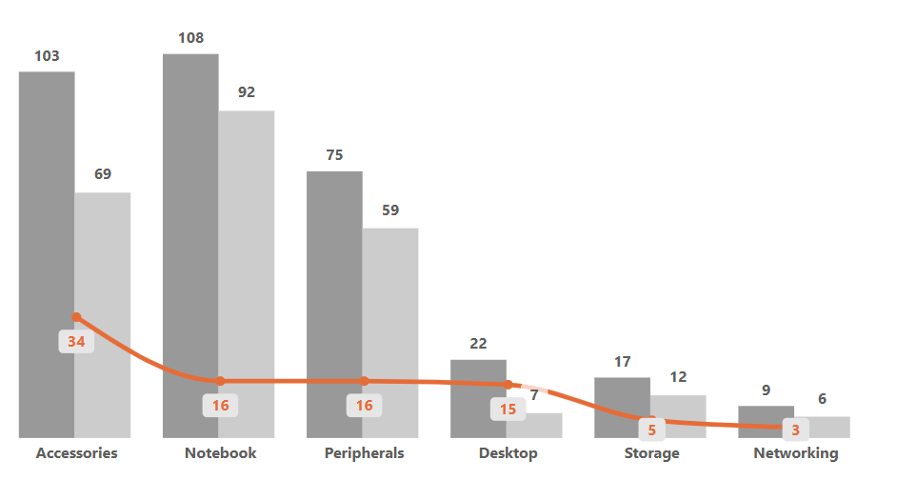
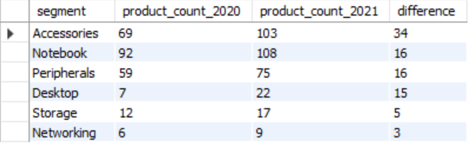
WHICH SEGMENT HAD THE MOST INCREASE SALES OF UNIQUE PRODUCTS IN 2021 VS 2020.

Slide 10
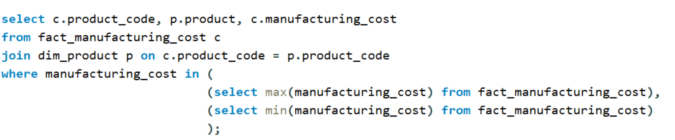
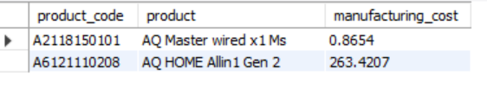
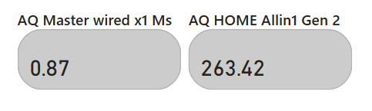
GET THE PRODUCTS THAT HAVE THE HIGHEST AND LOWEST MANUFACTURING COSTS.

Slide 11
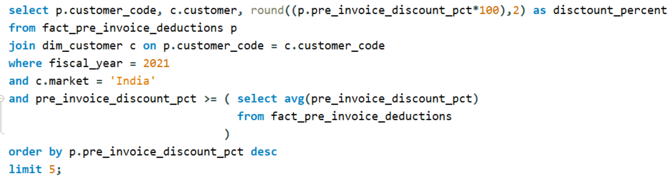
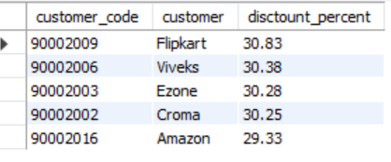
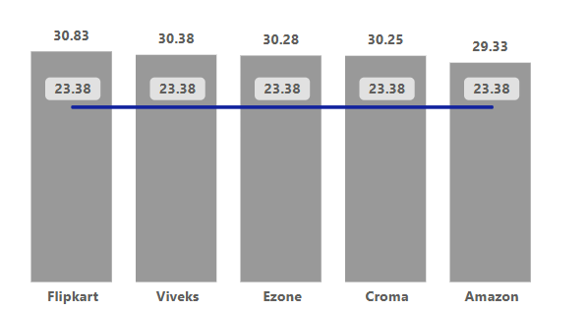
GENERATE A REPORT FOR TOP 5 CUSTOMERS IN INDIAN MARKET FOR FISCAL YEAR 2021 WHO RECEIVED THE PRE_INVOICE_DISCOUNT_PCT MORE THAN THE AVERAGE PRE_INVOICE_DISCOUNT_PCT

Slide 12
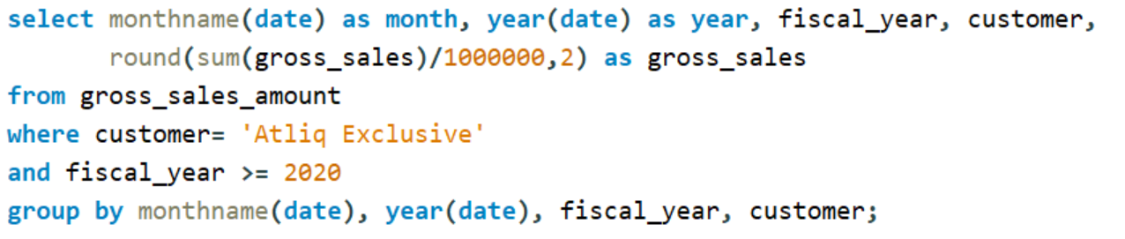
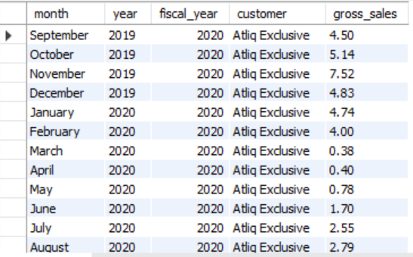
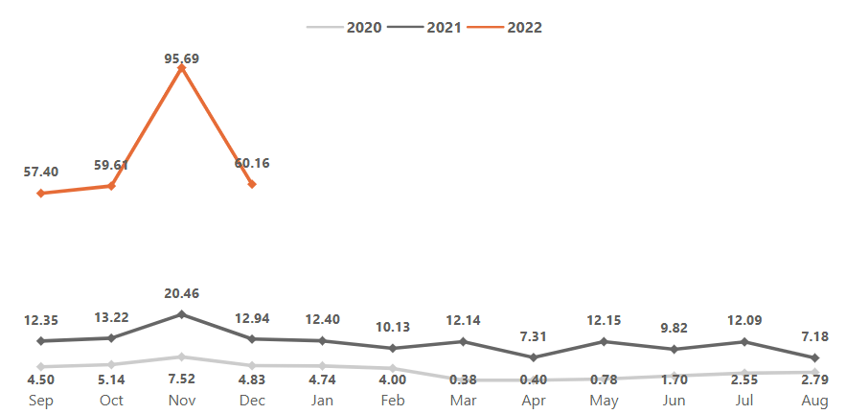
GENERATE A REPORT FOR "ATLIQ EXCLUSIVE" HAVING THE GROSS SALES AMOUNT OF EACH MONTH FOR FISCAL YEAR 2020 AND ONWARDS.

Slide 13
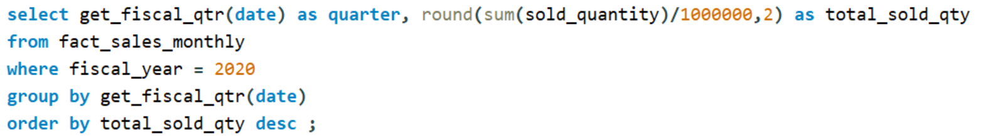
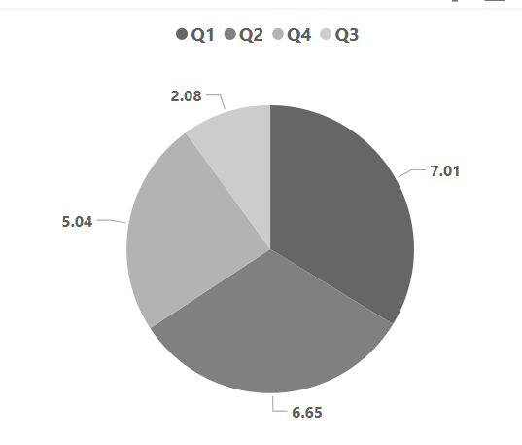
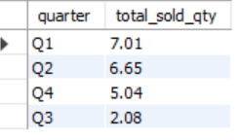
WHICH QUARTER OF 2020, OBSERVED THE MAXIMUM TOTAL_SOLD_QUANTITY

Slide 14
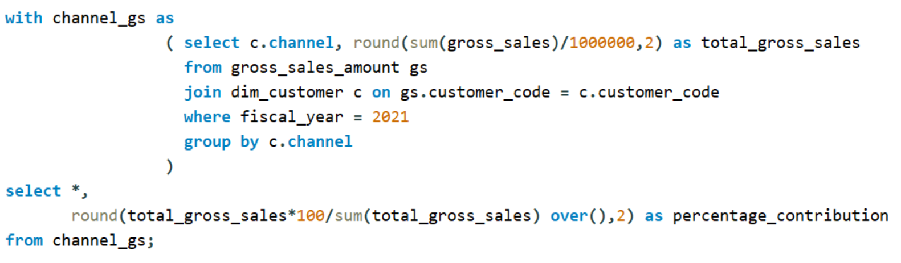
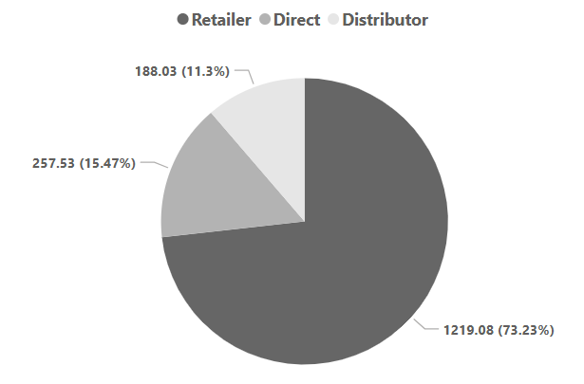
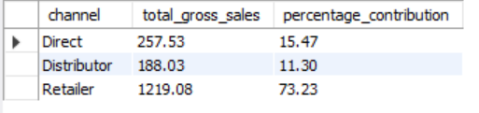
GENERATE A REPORT FOR THE GROSS SALES FOR THE FISCAL YEAR 2021 BASED ON THE CHANNEL AND WITH PERCENTAGE CONTRIBUTION.

Slide 15
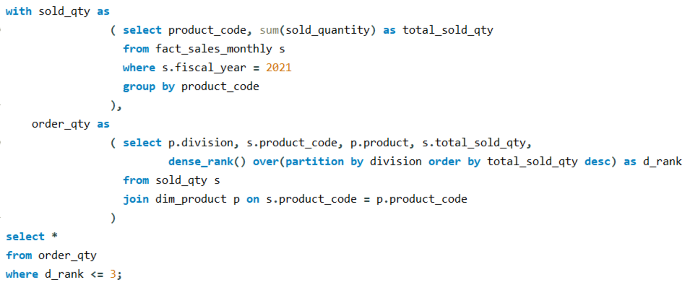
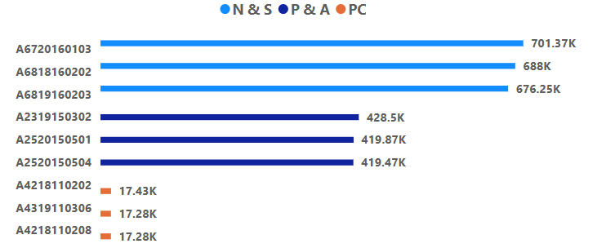
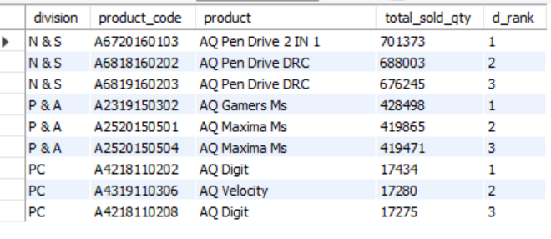
GET THE TOP 3 PRODUCTS IN EACH DIVISION HAVING HIGHEST TOTAL_SOLD_QUANTITY FOR THE FISCAL_YEAR 2021.

Slide 16
Thank You
LinkedIn :
https://www.linkedin.com/in/shubham-dhingra-020919129/
Github :
https://github.com/DhingraShubham
Portfolio :
https://codebasics.io/portfolio/Shubham-Dhingra

